Slide 1

$$τ=−κθ$$

Slide 2
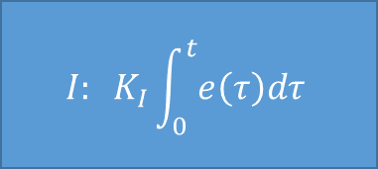
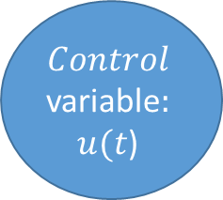

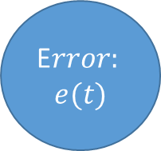

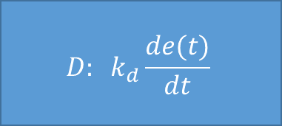
Controller:
$$P: K_{P}e\left(t\right)$$
$$Control$$
variable$:$
$u(t$)
Process output
E$rror:$
$$e(t)$$
$${I: K}_{I}\int_{0}^{t}{e\left(τ\right)dτ}$$
P$rocess$
Defined set point
Feedback variable
$$D: k_{d}\frac{de(t)}{dt}$$

